Slide 1
Statistical Modeling Explained in Python
Introduction to Multiple Regression
Multiple Regression (Analysis, Implications)
Shahzaib Hamid
AI Sciences Instructor

Slide 2
Module Overview
Introduction
Multiple Regression
Visual
Example
Model
Formula
Implications

Slide 3
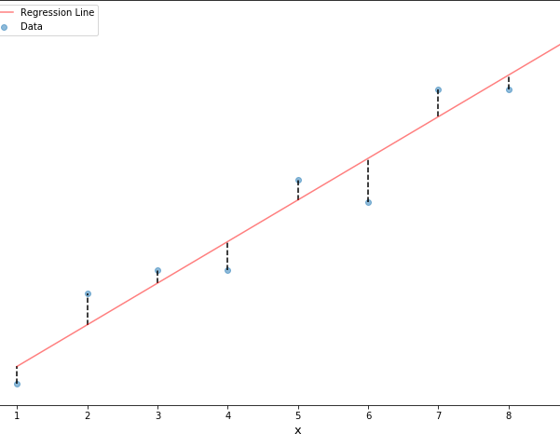
Multiple Regression Model
Multiple Regression

Slide 4
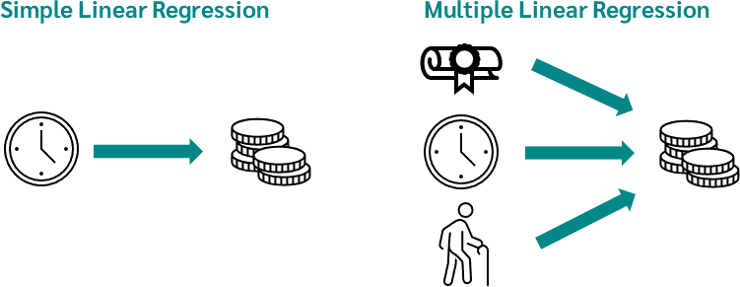
Multiple Regression (Example)

Slide 5
Multiple Regression(Formula)
The purpose of Multiple Linear Regression is to explain (the variation in) a dependent variable by (the variation in) two or many independent variables.
dependent Variable: Movie Revenue (Y)
independent Variables: Movie Budget, Runtime, Popularity, average Rating,
etc… (X₁, X₂, X₃)
→ Setting up a multiple linear model:
𝑌_{𝑖} = 𝑎 + 𝑏₁𝑋_{1𝑖} + 𝑏₂𝑋_{2𝑖} + ⋯ + 𝑏_{𝑘}𝑋_{𝑘𝑖} + 𝜀_{𝑖}
Revenue Budget Runtime Rating

Slide 6
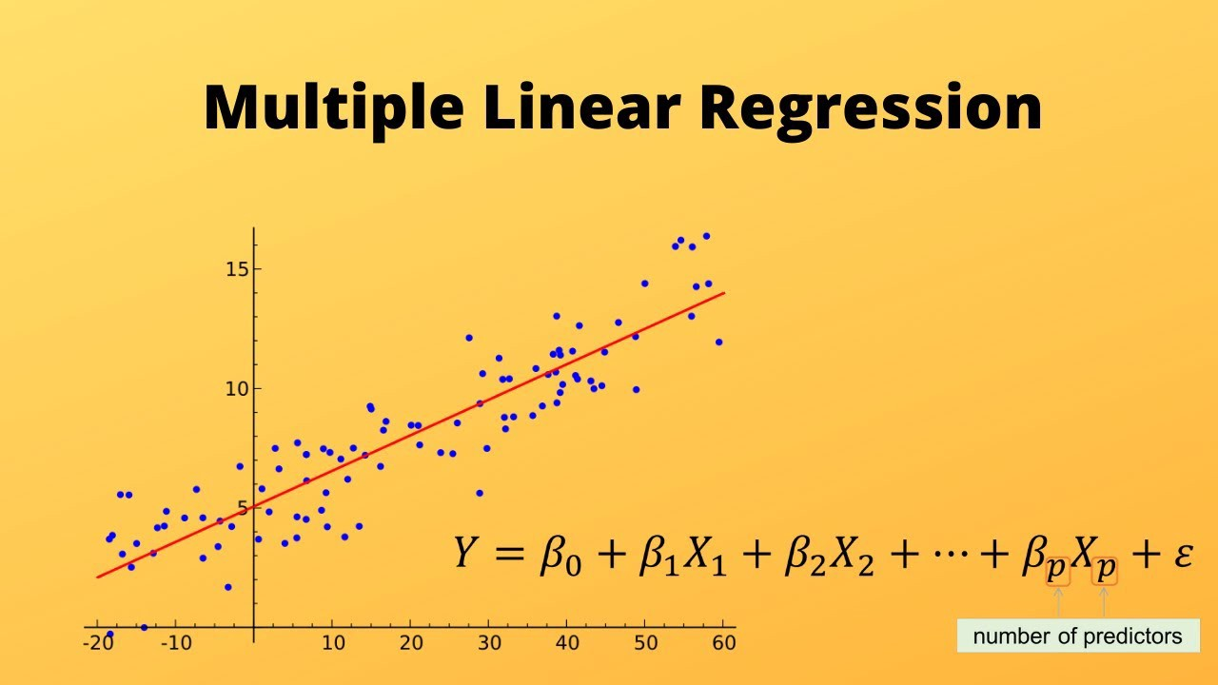
Multiple Regression(Visual)

Slide 7
Implications
Implications
captures correlations between independent variables.
By adding an additional independent variable:
The slope coefficients of other independent variables (can) change
The p-values of other independent variables (can) change
Significance of other independent variables (can) change → Remove
Omitting important independent variable(s) can distort the model.
Highly correlated independent variables can lead to Multicollinearity and requires model re-
specification (see next section).

